Slide 1
Inverse Kinematics In Games
Gordon Oboh
CS650-151 HY Artificial Intelligence
Professor Ruslan Yelizarov
Notes:
it's called "Inverse Kinematics" #shorts

Slide 2
Introduction
Objective
Inverse Kinematics (IK) is a powerful computational approach used extensively in both robotics and animation to calculate joint movements required to achieve precise end positions. Originating from robotic manipulations, IK plays a crucial role in creating realistic, dynamic, and responsive character movements in modern gaming, significantly enhancing player immersion and interaction.
Explore the role of Inverse Kinematics in creating realistic, dynamic movements within games.

Slide 3
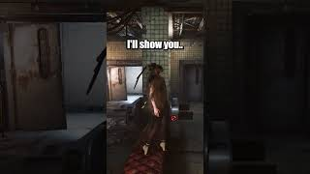
Introduction

Slide 4
Technological Analysis
Robotic Technology | Hardware | Software
Inverse Kinematics originated in robotics as a method to calculate how robotic joints must move to reach a desired position. The core robotics technologies involved include | Robots are composed of multiple rigid segments called links, connected by flexible points called joints. | IK algorithms calculate angles and positions of these joints to achieve precise end-effector positioning.

Slide 5
Realism & Immersion
Constraint Implementation
Dynamic Interactions
Complexity & Computation Cost
Creative Aspects
Characters move fluidly and naturally, fostering a believable world.
Designers must thoughtfully implement constraints (e.g., joint limits, collisions) inspired by robotics to maintain realism.
Characters adapt seamlessly to environmental variations without pre-scripted animations.
Accurate IK calculations require intensive computation, creating a potential performance overhead, especially in real-time gaming scenarios.

Slide 6
Commercial Impact
Games using IK-driven animations are praised for realism, significantly enhancing immersion and believability.
IK-driven realism frequently becomes a key marketing point, particularly in AAA games, directly influencing sales and brand reputation.

Slide 7
Commercial Impact
Technology | Strengths | Weaknesses | Commercial Reception
Inverse Kinematics | - Real-time adaptability - Enhanced realism - Improves immersion | - Computationally expensive - Occasional unnatural movements | Strong commercial success; praised by audiences for realism and immersion.
Traditional Keyframe Animation | - High artistic control - Predictable outcomes - Stylistic flexibility | - Less dynamic/responsive - Costly/time-consuming development | Mixed success; limited in real-time immersive experiences, strong in stylized narratives.
Motion Capture (Mocap) | - High realism and detail - Authentic human movements | - High production cost - Limited adaptability in real-time interactions | Strong commercial reception in AAA realism-driven titles, less flexible than IK alone.
Procedural Animation (Non-IK) | - Efficient for large-scale animations - Generates diverse movements | - Less realism in specific actions - Unpredictable outcomes | Varied reception; commercially viable in sandbox games but less realistic than IK/Mocap.

Slide 8
Predictive & Adaptive Animation
New Business Opportunities
Extended Reality Integration
Transforming Animation Workflow
Future Directions
Development of predictive IK algorithms that anticipate player actions, resulting in even smoother character interactions.
IK-driven technology advancements could open new markets, such as vtubers with realistic gestures.
Specialized IK systems optimized for XR interactions, enabling realistic hand-eye coordination, gesture recognition, and responsive avatars.
ML-driven IK could streamline animation processes, reducing manual labor and speeding up production cycles.

Slide 9
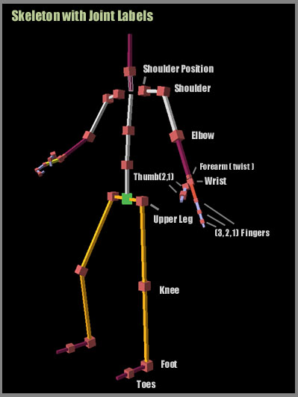
Conclusion
Inverse Kinematics stands at the forefront of animation technology, significantly enhancing gaming experiences through realistic and dynamic character interactions.
Despite being computationally intensive, IK's ability to boost realism and player immersion makes it highly valuable in commercial gaming markets.
Ongoing advancements, such as predictive algorithms and extended reality integrations, promise continued innovation.
Future developments in IK technology will further reshape animation workflows, creating new creative and commercial opportunities.
Notes:
Conclusion:
Inverse Kinematics (IK) significantly elevates gaming experiences by enabling realistic, responsive, and dynamic character animations. Originating from robotics technology, IK provides powerful tools for enhancing player immersion, storytelling depth, and user engagement. While IK introduces certain creative and computational challenges, its positive impact on audience reception and commercial success has been clearly demonstrated in acclaimed, commercially successful games like Red Dead Redemption 2 and The Last of Us Part II.
Looking ahead, IK innovation—particularly through integration with AI, machine learning, cloud technologies, and virtual reality—promises even greater realism, emotional expressiveness, and interactive possibilities. Such advancements have the potential to transform storytelling methods, set higher industry standards, and unlock new creative and commercial opportunities in entertainment.
Ultimately, IK remains a crucial technology poised to redefine the landscape of gaming and interactive storytelling, offering both creative potential and commercial advantages for the future of entertainment.

